Slide 1
3.23 Mock

Slide 2
Setter & constructor
If dependency can be overridden

Slide 3
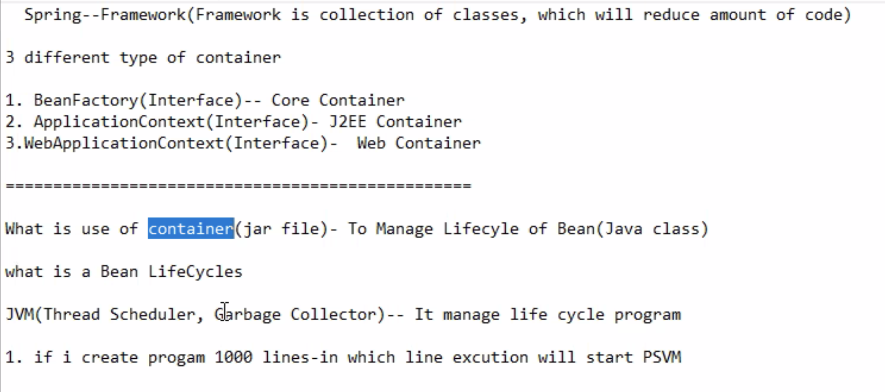

Slide 4
JVM
JVM (Thread Scheduler, Garbage Collector)
JVM manage the Life Cycle Program

Slide 5
What is container
The Spring container is at the core of the Spring Framework. The container will create the objects, wire them together, configure them, and manage their complete life cycle from creation till destruction. The Spring container uses DI to manage the components that make up an application.
To manage lifecycle of Bean (java class)

Slide 6
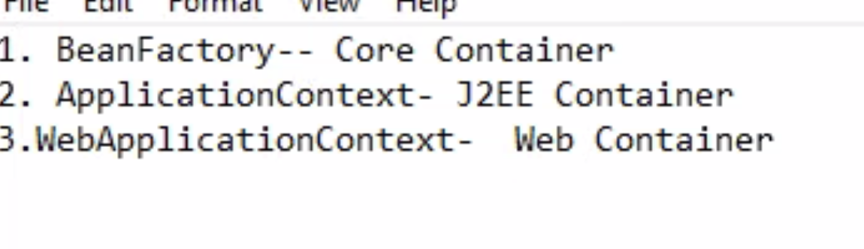
How many different types of spring boot containers are there?
BeanFactory – core container
ApplicationContext –J2EE Container
WebApplicationContext – web Container

Slide 7
HttpHeader

Slide 8
